Slide 1

School of Computer Science and Engineering
Data Mining and Data Warehouse

Slide 2
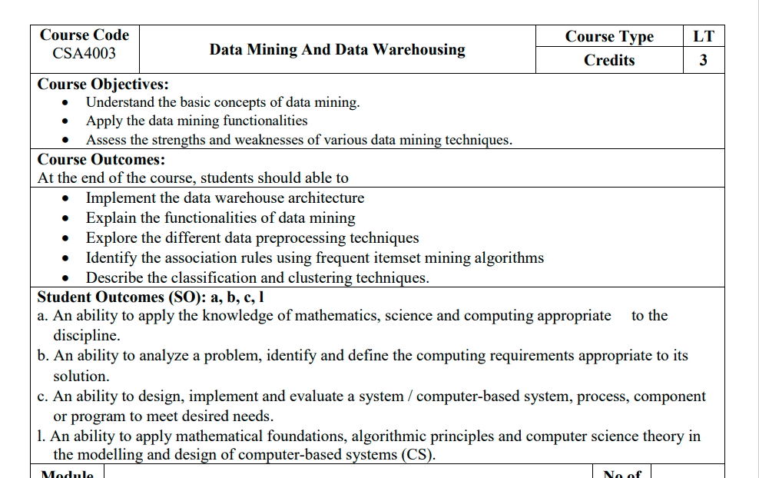
Course objective and outcomes

Slide 3
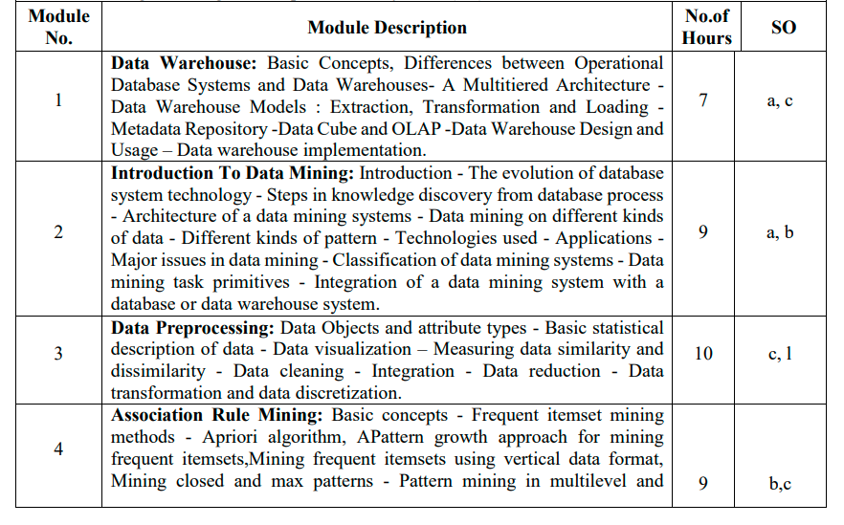
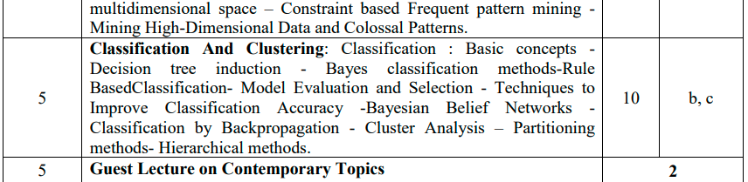
Syllabus

Slide 4
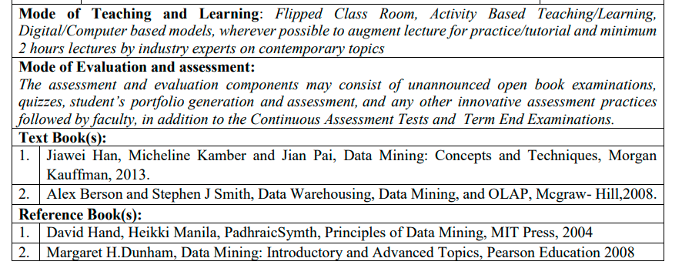
References

Slide 5
Syllabus for module 1
Data Warehouse:
Basic Concepts,
Differences between Operational Database Systems and Data Warehouses
A Multitiered Architecture
Data Warehouse Models : Extraction, Transformation and Loading
Metadata Repository :Data Cube and OLAP
Data Warehouse Design and Usage
Data warehouse implementation

Slide 6
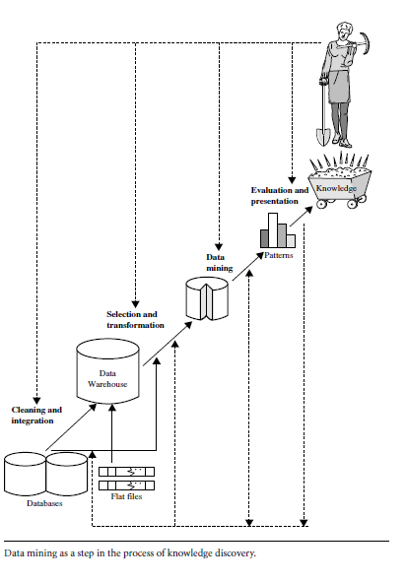
Knowledge Discovery from Data (KDD)

Slide 7
Data Warehouse

Slide 8
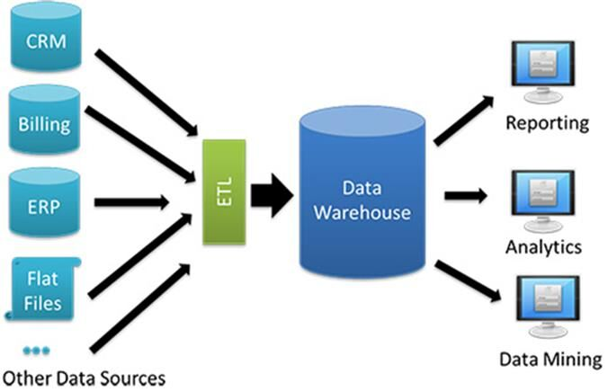
Data Warehouse

Slide 9
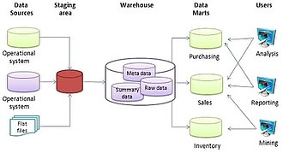
Data Warehouse

Slide 10
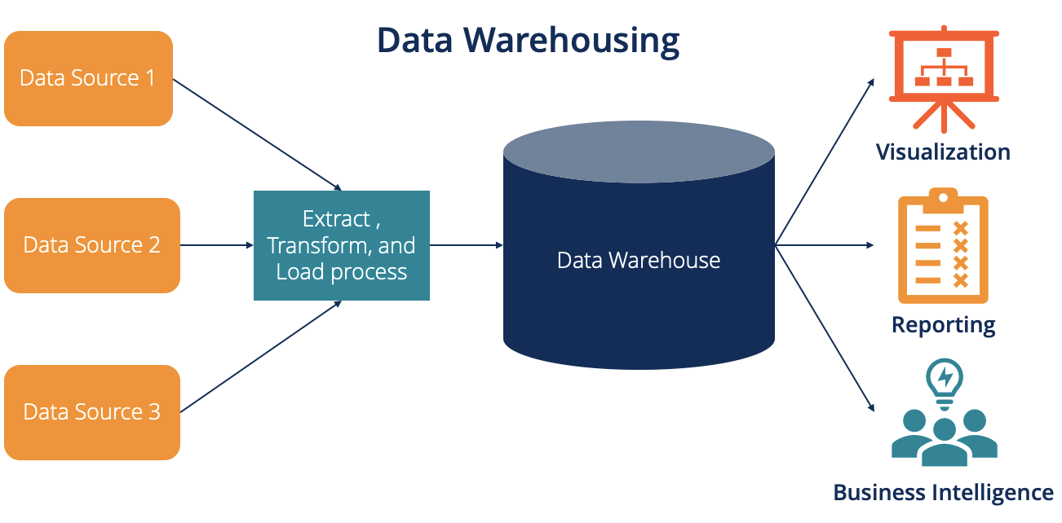
Data Warehouse

Slide 11
DW
” Data warehouses have been defined in many ways, making it difficult to formulate a rigorous definition. Loosely speaking, a data warehouse refers to a data repository that is maintained separately from an organization’s operational databases. Data warehouse systems allow for integration of a variety of application systems. They support information processing by providing a solid platform of consolidated historic data for analysis

Slide 12
Definition of DW
“A data warehouse is a subject-oriented, integrated, time-variant, and nonvolatile collection of data in support of management’s decision making process”
William H. Inmon,
A leading architect in the construction of data warehouse systems

Slide 13
Key features of Data Warehouse
Subject Oriented
Integrated
Time-variant
Nonvolatile

Slide 14
Subject Oriented:
A data warehouse is organized around major subjects such as customer, supplier, product, and sales. Rather than concentrating on the day-to-day operations and transaction processing of an organization, a data warehouse focuses on the modeling and analysis of data for decision makers. Hence, data warehouses typically provide a simple and concise view of particular subject issues by excluding data that are not useful in the decision support process.

Slide 15
Integrated
A data warehouse is usually constructed by integrating multiple heterogeneous sources, such as relational databases, flat files, and online transaction records. Data cleaning and data integration techniques are applied to ensure consistency in naming conventions, encoding structures, attribute measures, and so on

Slide 16
Time-Variant
Data are stored to provide information from an historic perspective (e.g., the past 5–10 years). Every key structure in the data warehouse contains, either implicitly or explicitly, a time element.

Slide 17
Nonvolatile:
A data warehouse is always a physically separate store of data transformed from the application data found in the operational environment. Due to this separation, a data warehouse does not require transaction processing, recovery, and concurrency control mechanisms. It usually requires only two operations in data accessing: initial loading of data and access of data

Slide 18
Differences between Operational Database Systems and DW
The major task of online operational database systems is to perform online transaction and query processing. These systems are called online transaction processing (OLTP) systems.
Data warehouse systems, on the other hand, serve users or knowledge workers in the role of data analysis and decision making. Such systems can organize and present data in various formats in order to accommodate the diverse needs of different users. These systems are known as online analytical processing (OLAP) systems.

Slide 19
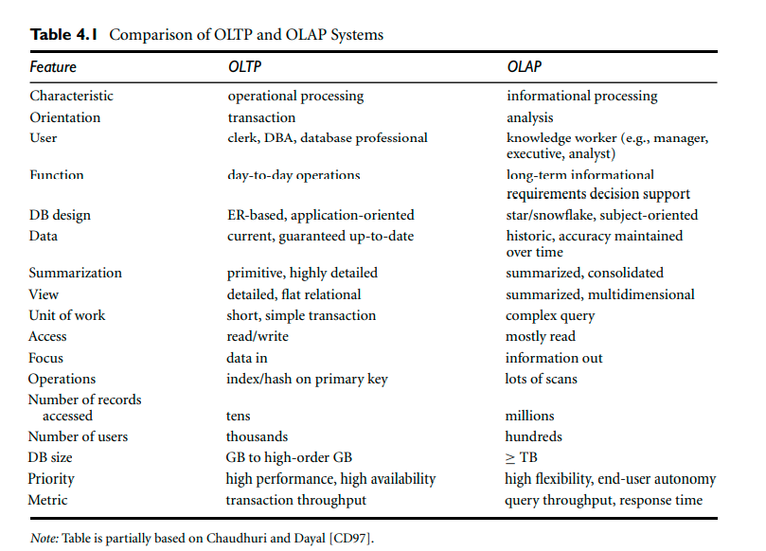
Differences between Operational Database Systems and DW

Slide 20
Explanation of differences between OLTP and OLAP
Users and system orientation:
An OLTP system is customer-oriented and is used for transaction and query processing by clerks, clients, and information technology professionals. An OLAP system is market-oriented and is used for data analysis by knowledge workers, including managers, executives, and analysts.
Data contents:
An OLTP system manages current data that, typically, are too detailed to be easily used for decision-making. An OLAP system manages large amounts of historic data, provides facilities for summarization and aggregation, and stores and manages information at different levels of granularity. These features make the data easier to use for informed decision making
Database design: An OLTP system usually adopts an entity-relationship (ER) data model and an application-oriented database design. An OLAP system typically adopts either a star or a snowflake model (see Section 4.2.2) and a subject-oriented database design.
View:
An OLTP system focuses mainly on the current data within an enterprise or department, without referring to historic data or data in different organizations. In contrast, an OLAP system often spans multiple versions of a database schema, due to the evolutionary process of an organization. OLAP systems also deal with information that originates from different organizations, integrating information from many data stores. Because of their huge volume, OLAP data are stored on multiple storage media.
Access patterns:
The access patterns of an OLTP system consist mainly of short, atomic transactions. Such a system requires concurrency control and recovery mechanisms. However, accesses to OLAP systems are mostly read-only operations (because most data warehouses store historic rather than up-to-date information), although many could be complex queries.

Slide 21
Why Have a Separate Data Warehouse???

Slide 22
Ans: To promote the high performance of both systems.
Explanation:
An operational database is designed and tuned from known tasks and workloads like indexing and hashing using primary keys, searching for particular records, and optimizing queries.
While, data warehouse queries are often complex. They involve the computation of large data groups at summarized levels, and may require the use of special data organization, access, and implementation methods based on multidimensional views.
Processing OLAP queries in operational databases would substantially degrade the performance of operational tasks.
Moreover, an operational database supports the concurrent processing of multiple transactions. Concurrency control and recovery mechanisms (e.g., locking and logging) are required to ensure the consistency and robustness of transactions. An OLAP query often needs read-only access of data records for summarization and aggregation. Con-currency control and recovery mechanisms, if applied for such OLAP operations, may jeopardize the execution of concurrent transactions and thus substantially reduce the throughput of an OLTP system.

Slide 23
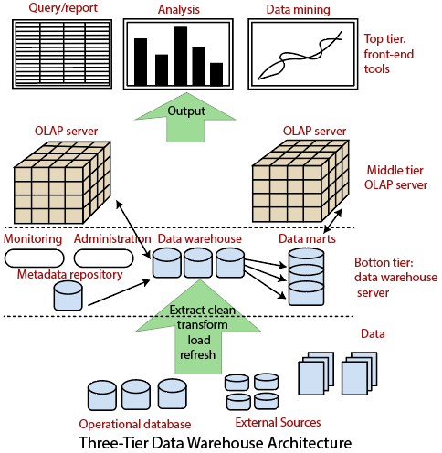
A Multitier
Architecture
of DW

Slide 24
The bottom tier is a warehouse database server that is almost always a relational database system. Back-end tools and utilities are used to feed data into the bottom tier from operational databases or other external sources. These tools and utilities perform data extraction, cleaning, and transformation as well as load and refresh functions to update the data warehouse. The data are extracted using application program interfaces known as gateways. A gateway is supported by the underlying DBMS and allows client programs to generate SQL code to be executed on a server. Examples of gateways include ODBC (Open Database Connection) and OLEDB (ObjecLinking and Embedding Database) by Microsoft and JDBC (Java Database Connection). This tier also contains a metadata** repository, which stores information about the data warehouse and its contents.
Description of Architecture of DW

Slide 25
The middle tier is an OLAP server that is typically implemented using either (1) a relational OLAP (ROLAP) model (i.e., an extended relational DBMS that maps operations on multidimensional data to standard relational operations); or (2) a multidimensional OLAP (MOLAP) model (i.e., a special-purpose server that directly implements multidimensional data and operations).

Slide 26
The top tier is a front-end client layer, which contains query and reporting tools, analysis tools, and/or data mining tools (e.g., trend analysis, prediction, and so on).

Slide 27
Metadata repository: (from bottom tier)
Metadata are the data that define warehouse objects.
Metadata are created for the data names and definitions of the given warehouse. Additional metadata are created and captured for timestamping any extracted data, the source of the extracted data, and missing fields that have been added by data cleaning or integration processes

Slide 28
A metadata repository should contain…
A description of the data warehouse structure, which includes the warehouse schema, view, dimensions, hierarchies, and derived data definitions, as well as data mart locations and contents.
Operational metadata, which include data lineage (history of migrated data and the sequence of transformations applied to it), currency of data (active, archived, or purged), and monitoring information (warehouse usage statistics, error reports, and audit trails).
The algorithms used for summarization, which include measure and dimension definition algorithms, data on granularity, partitions, subject areas, aggregation, summarization, and predefined queries and reports.
Mapping from the operational environment to the data warehouse, which includes source databases and their contents, gateway descriptions, data partitions, data extraction, cleaning, transformation rules and defaults, data refresh and purging rules, and security (user authorization and access control).

Slide 29
A metadata repository should contain…
Data related to system performance, which include indices and profiles that improve data access and retrieval performance, in addition to rules for the timing and scheduling of refresh, update, and replication cycles.
Business metadata, which include business terms and definitions, data ownership information, and charging policies.

Slide 30
OLAP Server Architectures:
ROLAP: Relational Online Analytical Processing
MOLAP: Multidimensional Online Analytical Processing
HOLAP: Hybrid Online Analytical Processing

Slide 31
ROLAP stores data in columns and rows (also known as relational tables) and retrieves the information on demand through user submitted queries. A ROLAP database can be accessed through complex SQL queries to calculate information. ROLAP can handle large data volumes, but the larger the data, the slower the processing times.
Because queries are made on-demand, ROLAP does not require the storage and pre-computation of information. However, the disadvantage of ROLAP implementations are the potential performance constraints and scalability limitations because of large and inefficient join operations between large tables. Examples of popular ROLAP products include
Metacube by Stanford Technology Group,
Red Brick Warehouse by Red Brick Systems, and
AXSYS Suite by Information Advantage.

Slide 32
MOLAP servers support multidimensional data views through array-based multidimensional storage engines.
MOLAP uses a multidimensional cube that accesses stored data through various combinations. Data is pre-computed, pre-summarized, and stored (a difference from ROLAP, where queries are served on-demand).
A multicube approach has proved successful in MOLAP products. In this approach, a series of dense, small, precalculated cubes make up a hypercube. Tools that incorporate MOLAP include Oracle Essbase, IBM Cognos, and Apache Kylin.
Its simple interface makes MOLAP easy to use, even for inexperienced users. Its speedy data retrieval makes it the best for “slicing and dicing” operations. One major disadvantage of MOLAP is that it is less scalable than ROLAP, as it can handle a limited amount of data.

Slide 33
HOLAP
Hybrid is a combination of both ROLAP and MOLAP.It offers functionalities of both ROLAP and as well as MOLAP like faster computation of MOLAP and higher scalability of ROLAP. The aggregations are stored separately in MOLAP store. Its server allows storing the large data volumes of detailed information

Slide 34
Data Warehouse Models:
Enterprise Warehouse,
Data Mart, and
Virtual Warehouse

Slide 35
Enterprise warehouse:
An enterprise warehouse collects all of the information about subjects covering the entire organization. It provides corporate-wide data integration, usually from one or more operational systems or external information providers. It typically contains detailed data as well as summarized data, and can range in size from a few gigabytes to hundreds of gigabytes, terabytes, or beyond. An enterprise data warehouse may be implemented on traditional mainframes, computer superservers, or parallel architecture platforms. It requires extensive business modeling and may take years to design and build

Slide 36
Data mart:
A data mart contains a subset of corporate-wide data that is of value to a specific group of users. The scope is confined to specific selected subjects. For example, a marketing data mart may confine its subjects to customers, items, and sales. The data contained in data marts tend to be summarized. The implementation cycle of a data mart is more likely to be measured in weeks rather than months or years. However, it may involve complex integration in the long run if its design and planning were not enterprise-wide. Depending on the source of data, data marts can be categorized as independent or dependent. Independent data marts are sourced from data captured from one or more operational systems or external information providers, or from data generated locally within a particular department or geographic area. Dependent data marts are sourced directly from enterprise data warehouse

Slide 37
Virtual warehouse:
A virtual warehouse is a set of views over operational databases. For efficient query processing, only some of the possible summary views may be materialized. A virtual warehouse is easy to build but requires excess capacity on operational database servers

Slide 38
Data Marts vs. Centralized Data Warehouse: Use Cases
Data Marts Use Cases
Marketing analysis and reporting favor a data mart approach because these activities are typically performed in a specialized business unit, and do not require enterprise-wide data.
A financial analyst can use a finance data mart to carry out financial reporting.
Centralized Data Warehouse Use Cases
A company considering an expansion needs to incorporate data from a variety of data sources across the organization to come to an informed decision. This requires a data warehouse that aggregates data from sales, marketing, store management, customer loyalty, supply chains, etc.
Many factors drive profitability at an insurance company. An insurance company reporting on its profits needs a centralized data warehouse to combine information from its claims department, sales, customer demographics, investments, and other areas.

Slide 39
1. GENERALISATION 2. AGGREGATION 3. SUMMARISATION 4. Data warehouse 5. Data mart 6. Enterprise warehouse 7. Virtual warehouse 8. Characteristics of DW 9. Multitier architecture 10. Meta data repository 11. OLTP 12. OLAP 13. Difference between OLTP and OLAP 14. MOLAP 15. ROLAP 16. HOLAP
Now Familiar terms

Slide 40
Thank You

